Slide 1
Assessment 1
ADAD3402 Interactive Generative Visualisations
z5158177
Yicheng PAN

Slide 2
CONTENTS
1
The Concept
2
Aspects of Working System
3
A Walk Through of the Interaction Scenario
4
Production Timeline

Slide 3
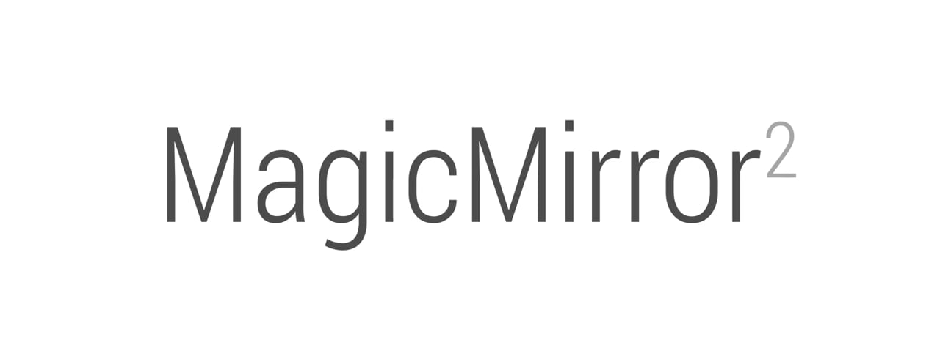
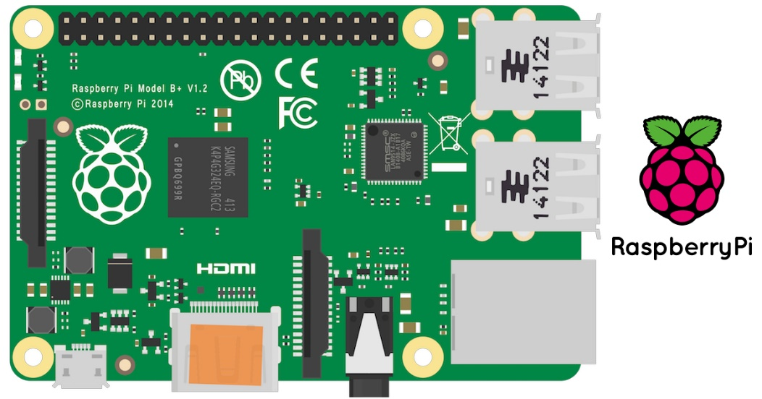
The Concept
MagicMirror² is an open source modular smart mirror platform. With a growing list of installable modules, the MagicMirror² allows you to convert your hallway or bathroom mirror into your personal assistant. MagicMirror² is built by the creator of the original MagicMirror with the incredible help of a growing community of contributors.

Slide 4
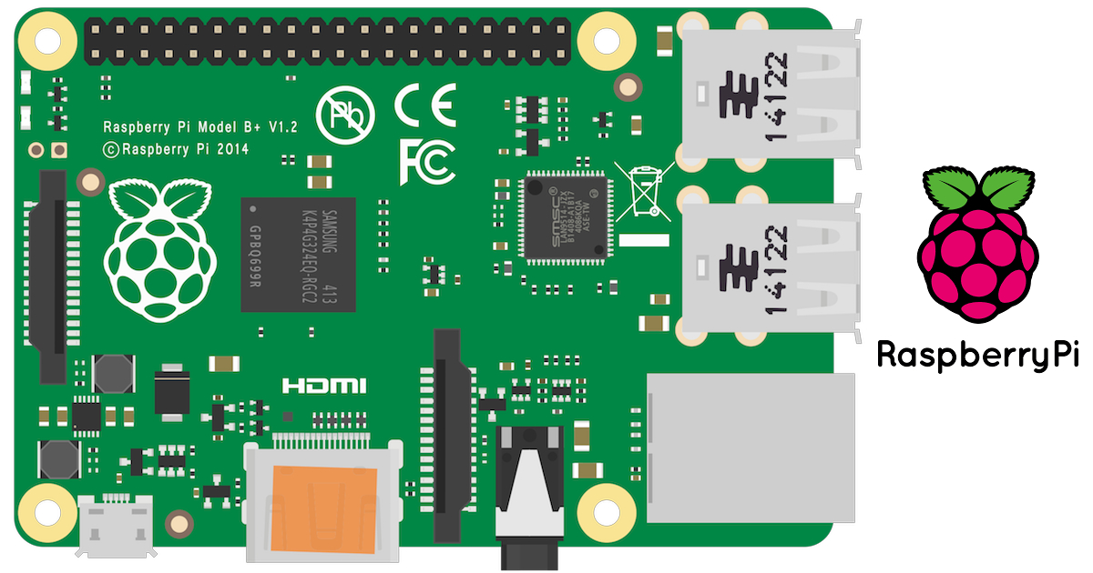
Working System
Dynamic screens which can be touched and gestured to create a variety of interaction
When no contact is detected, it can automatically play music and loop special effects
The top of the screen will be covered with a layer of one-way glass. In the eyes of the user, this screen can see the information of the user and the screen superimposed on each other at the same time. Different directions and light will cause different transparency, thereby creating more interaction

Slide 5
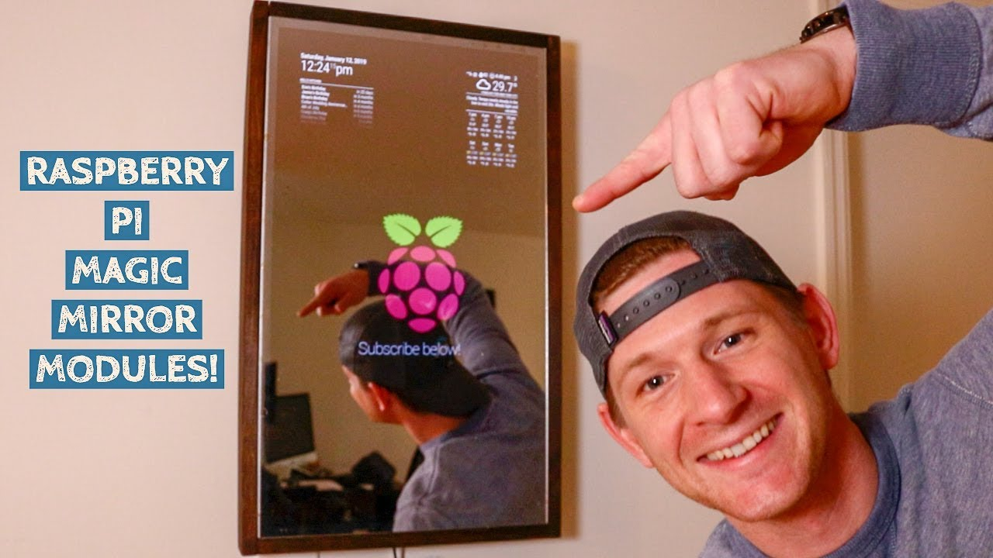
https://vimeo.com/171152845
HERE IS THE VIDEO LINK

Slide 6
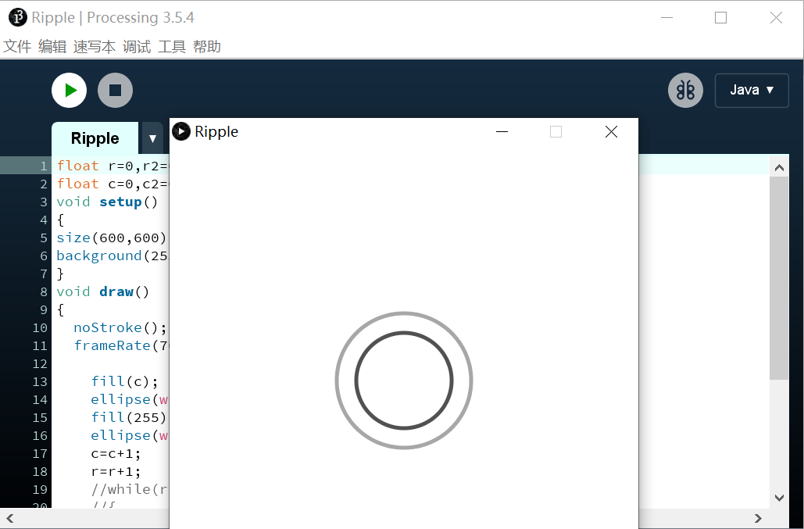
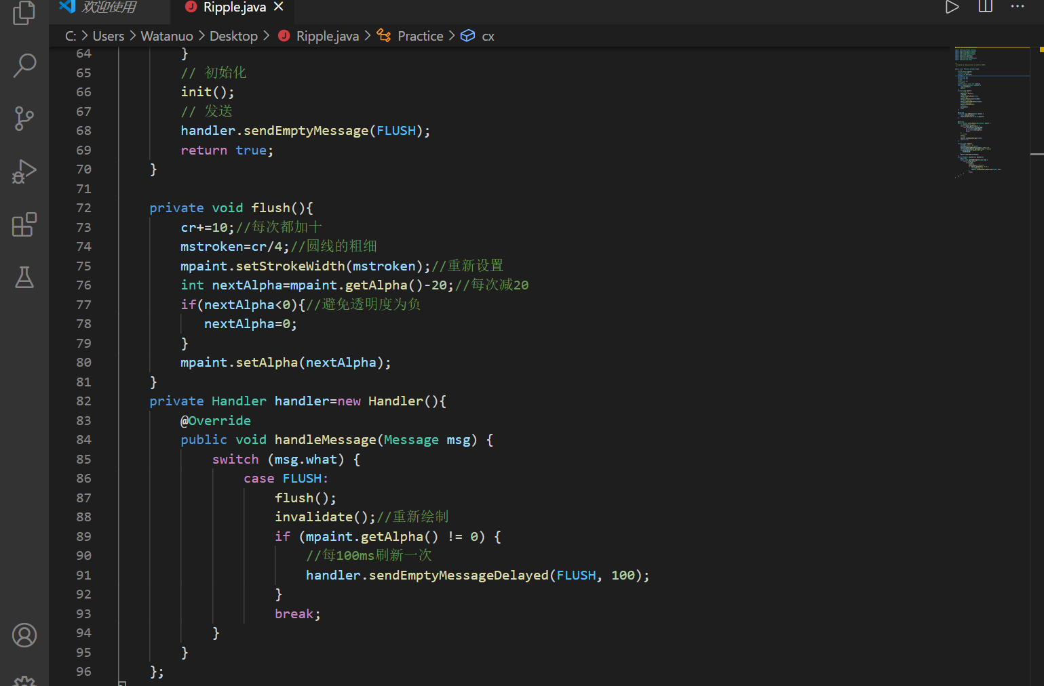
Interaction principle
Touch the screen to get special effects feedback
Can still provide dynamic effects without interaction

Slide 7
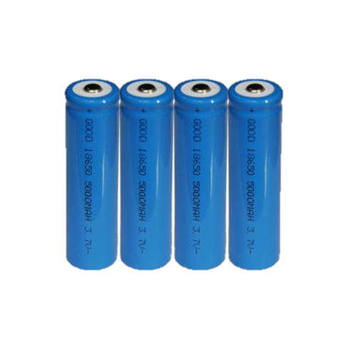
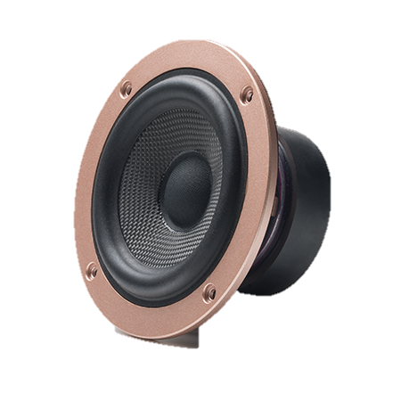

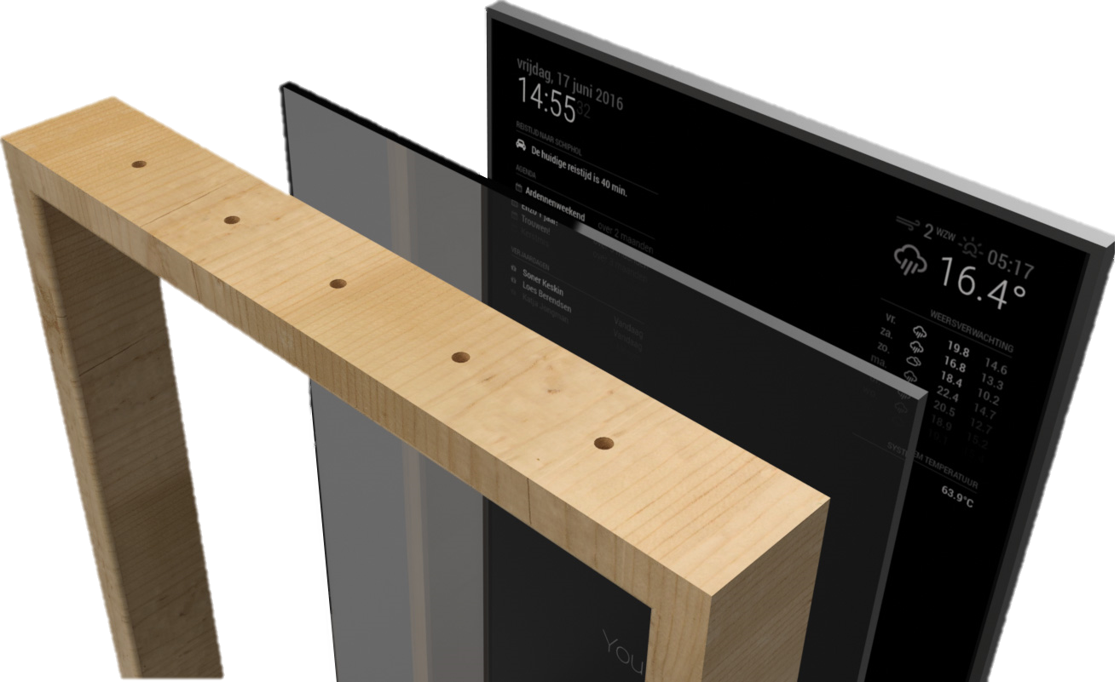
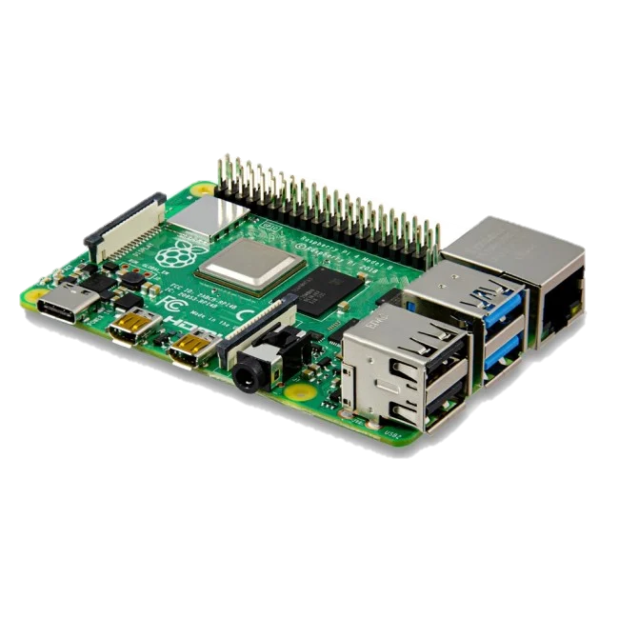
Interaction Scenario

Slide 8
01
The entire device may not be able to show a variety of interactivity by receiving screen size restrictions
Possible Limitations
02
The transmission effect of unidirectional glass may need more evaluation
03
Can't provide a very powerful sense of immersion

Slide 9
List of materials
1.
LCD Touchable Screen
2.
Raspberry Pi 4
3.
Pine Board
4.
18650 Battery
5.
Single-sided glass
6.
Speaker (Optional)
7.
Power strip and cord

Slide 10
Production Timeline
Jun 1 - Jun 4
Installation Proposal
Jun 8 - Jun 16
Connect Raspberry Pi
Jun 15 - Jul 5
Write the main program and graphical interface
Jul 1 - Jul 11
Test program and hardware interaction
Jul 20 - Jul 27
Debug
Final improvements and adjustments
Jul 1 - Jul 29
Record interactions and submit
Jun 27 - Jul 29
Start Date
Due Date
Jun 1
Jul 29
2020
Today
May
June
July
2020

Slide 11
THANKS
z5158177
Yicheng PAN

